Slide 1

KCB TOWERS ANALYSIS

Slide 2
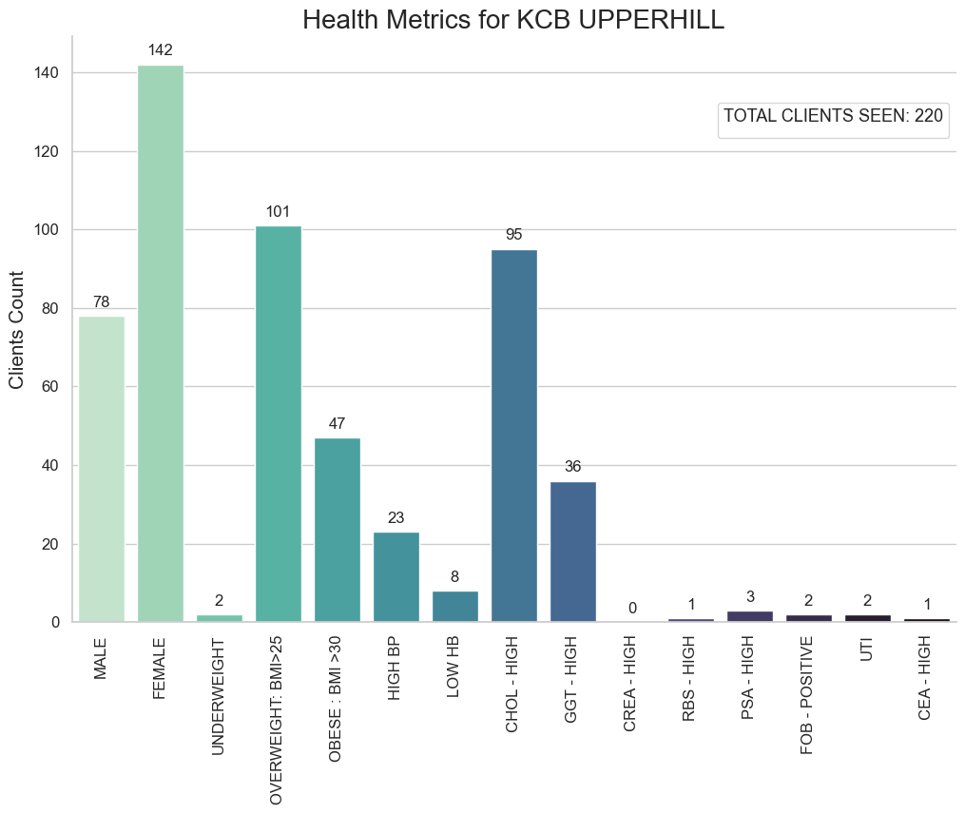
KCB TOWERS
The bar chart provides a comprehensive overview of the health metrics and conditions among 220 individuals associated with the KCB Upperhill branch.Gender distribution shows a slight skew towards females, with 78 males and 142 females in the sampled population. Body Mass Index (BMI) analysis highlights a prevalence of weight-related concerns, with the majority classified as overweight (101) and obese (47), signaling potential risks for obesity-related complications. Various health conditions such as high blood pressure, low hemoglobin, and high cholesterol levels were observed, suggesting potential cardiovascular and liver health risks within the population observed.
In light of these findings, targeted interventions are recommended to address the identified health challenges. Strategies focused on weight management, lifestyle modifications, and regular health screenings could mitigate risk factors associated with observed health conditions, promoting better health outcomes for individuals within the KCB Upperhill branch.

Slide 3
Analysis done by D&W Data Solutions

